Slide 1
Microeconomics for Business
Chapter 13 – Externalities
Overview

Slide 2
Review
Do markets allocate goods efficiently?

Slide 3
Review
How do they allocate goods efficiently?

Slide 4
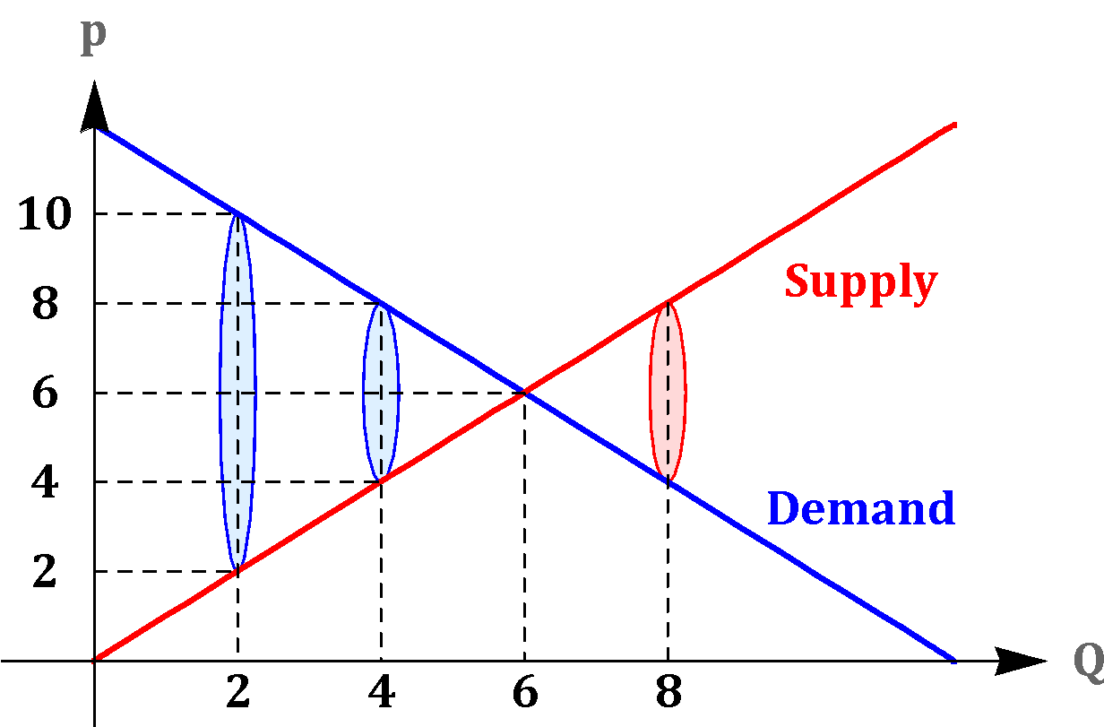
Overview
Efficiency: maximization of total surplus

Slide 5
Overview
Buyer

Slide 6
Overview
Buyer
Seller

Slide 7
Overview
Buyer
Positive Surplus
Seller

Slide 8
Overview
Buyer

Slide 9
Overview
(Cost)
(Value)

Slide 10
Overview
Value > Cost
Efficient to Trade
(Positive Surplus)
(Cost)
(Value)

Slide 11
Overview
Value < Cost
Inefficient to Trade
(Negative Surplus)
(Cost)
(Value)

Slide 12
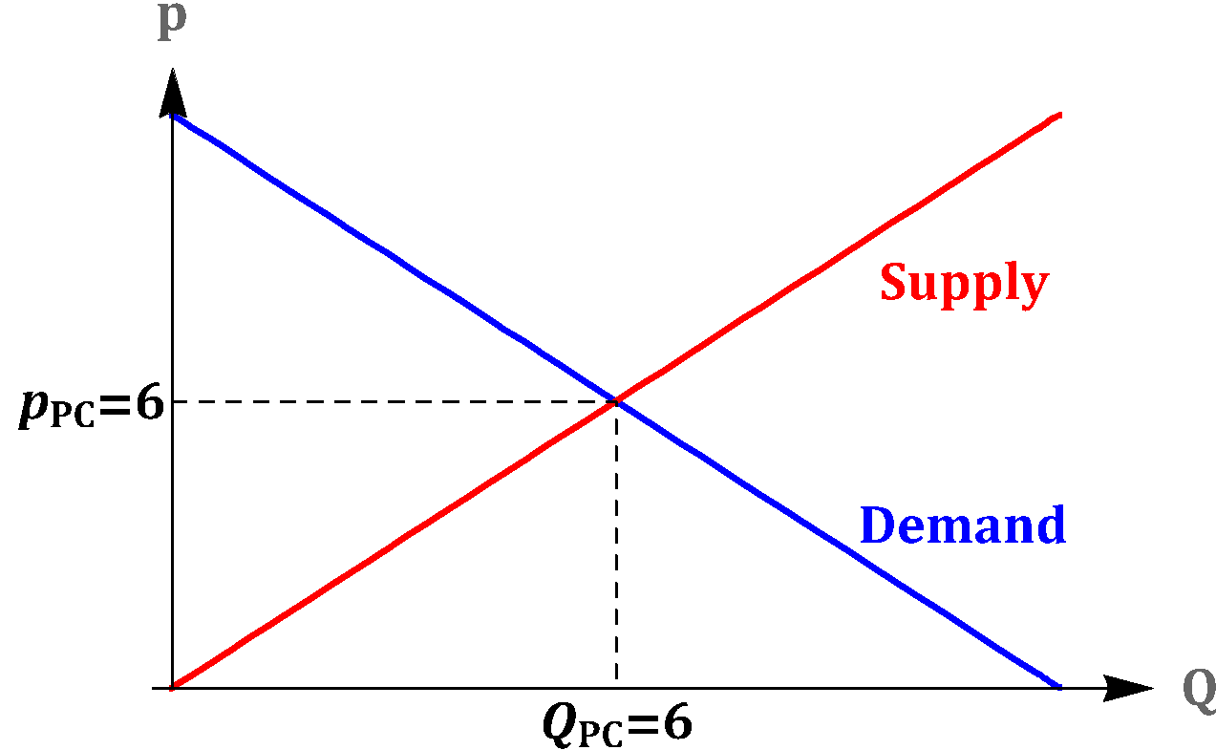
Overview
(Cost)
(Value)

Slide 13
Overview
(Cost)
(Value)
Efficient Outcome

Slide 14
Overview
In perfectly competitive markets, the sole objective of each firm is to maximize its own profit, while the sole objective of each consumer is to maximize her own utility.
Nevertheless, the forces of demand and supply are able to efficiently allocate resources in the economy.
Key forces: market prices, which provide the incentives for consumers and producers to make socially efficient choices.

Slide 15
Why do Markets Fail?
information is incomplete
there are costs or benefits external to the market.
goods are non-excludable.
firms have too much market power.

Slide 16

What is more important?
Right to Party
Right to Peace and Quiet

Slide 17
Overview
Sometimes the market fails to incorporate costs and benefits into the price of a good.

Slide 18
Overview
Sometimes the market fails to incorporate costs and benefits into the price of a good.
An externality occurs when the activities or actions of one economic agent affect other economic agents in a way that is not directly reflected in a market.

Slide 19
Overview
Sometimes the market fails to incorporate costs and benefits into the price of a good.
An externality occurs when the activities or actions of one economic agent affect other economic agents in a way that is not directly reflected in a market.
Positive Externality: if the action benefits others

Slide 20
Overview
Sometimes the market fails to incorporate costs and benefits into the price of a good.
An externality occurs when the activities or actions of one economic agent affect other economic agents in a way that is not directly reflected in a market.
Positive Externality: if the action benefits others
Negative Externality: if the action causes harm to others

Slide 21
In Groups
Come up with a good with a negative externality and one with a positive externality

Slide 22
Overview
Example:
A factory producing a good and, in the process, generating pollution that negatively affects a nearby village.
Firm and consumers are not taking into account the fact that the production of the good harms the nearby village.
Choices in this market will be socially inefficient because of this negative externality (too much of this product will be produced).

Slide 23
Overview
Example:
A homeowner deciding whether to renovate her old house.
The owner and the contractor are not taking into account the potential benefit that is enjoyed by neighbors who like to live in a renovated neighborhood.
Choices in this market will be socially inefficient because of this positive externality (too few renovations will take place).

Slide 24
Overview
In summary, when externalities exist, the market outcome will be inefficient because the price is not fully reflecting the true social benefits and costs.

Slide 25
Microeconomics for Business
Chapter 13 – Externalities and Public Goods
Negative Externalities

Slide 26
Negative Externalities
Negative externality happens when the actions of economic agents cause harm to others, but this is not reflected in the market.
This harm is a cost for society that is not captured by prices, which results in inefficient choices.

Slide 27
Antibiotics
Each time you use antibiotics you are contributing to the creation of “superbugs”
No one pays for this biological process
Should we ban antibiotics?

Slide 28
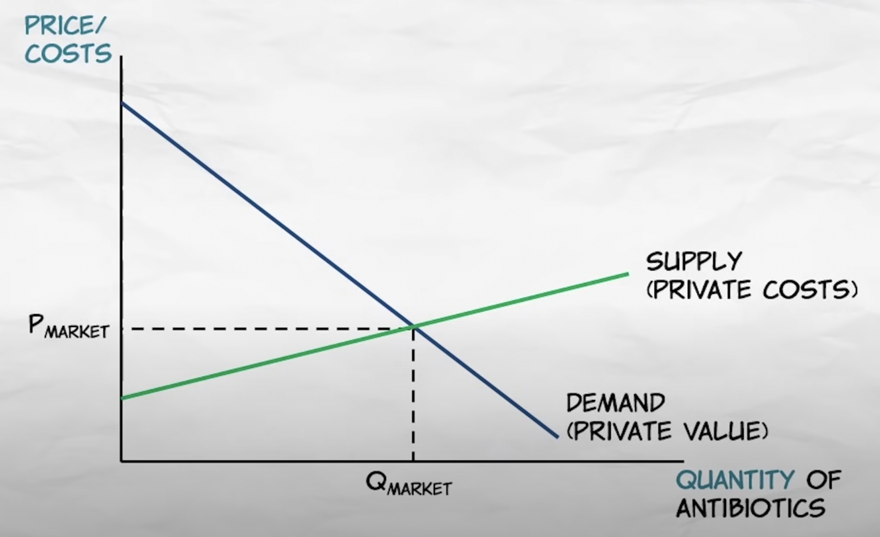

Slide 29
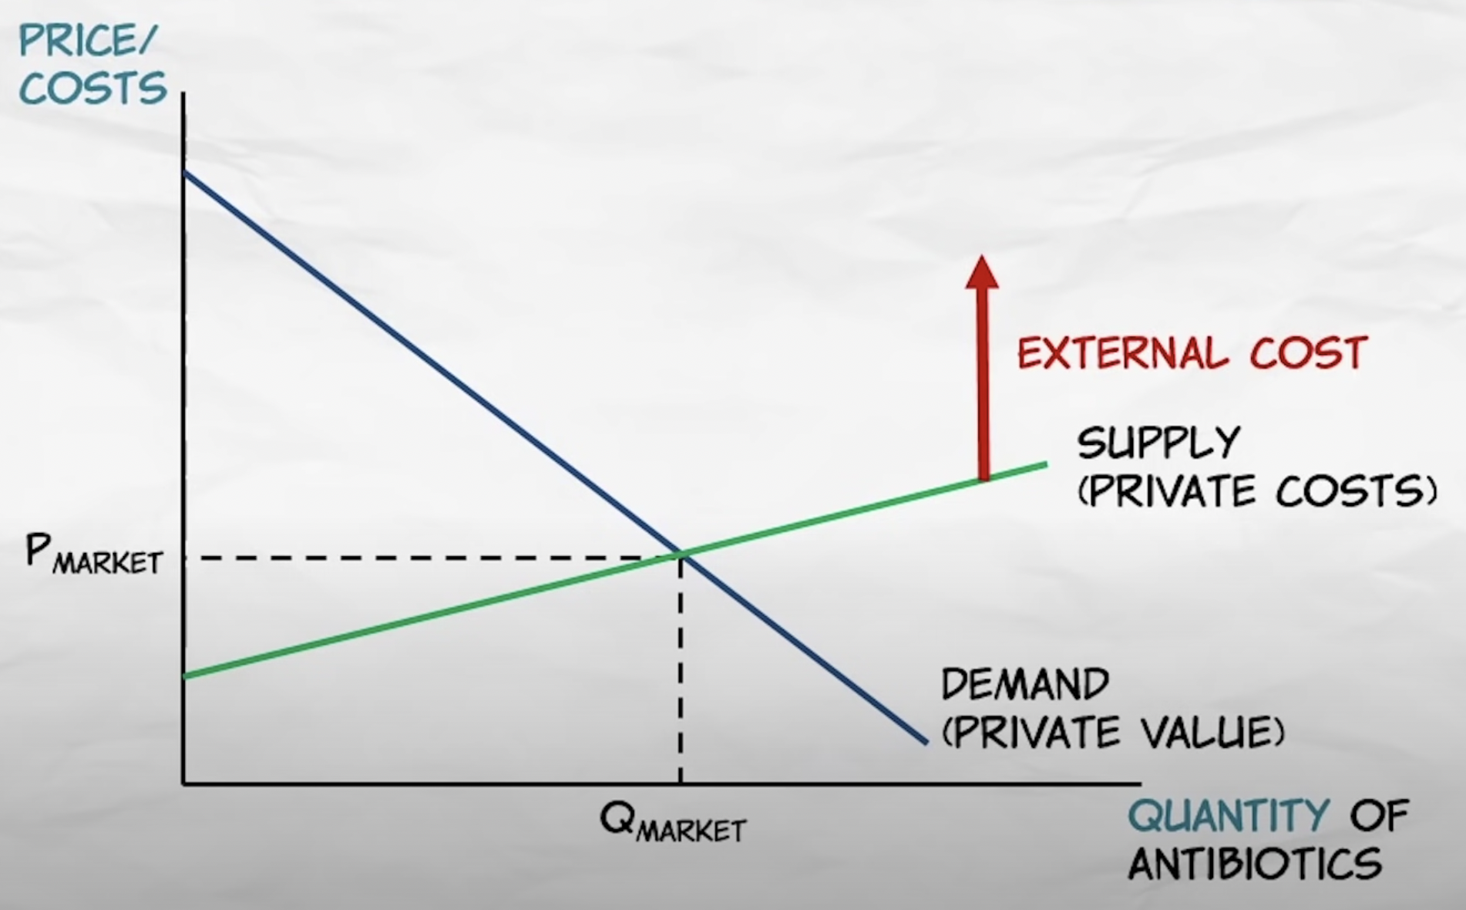

Slide 30
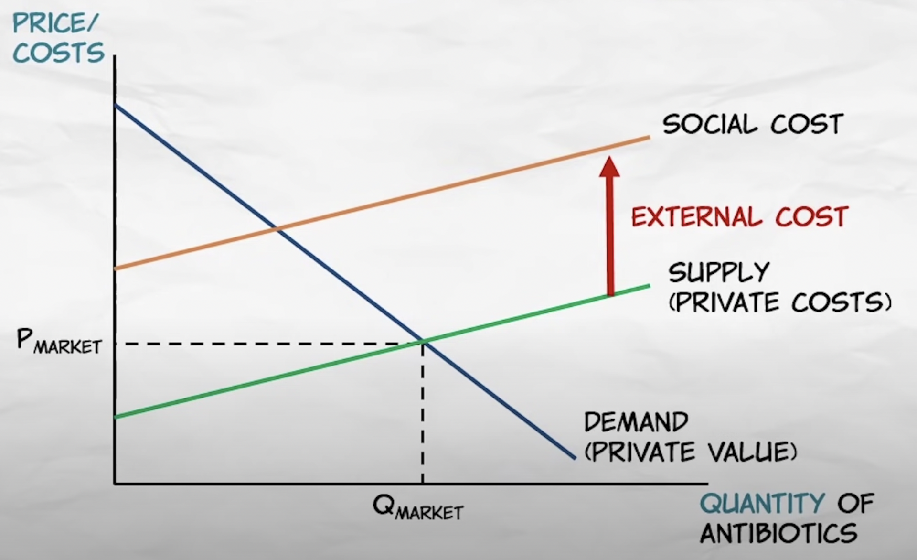

Slide 31
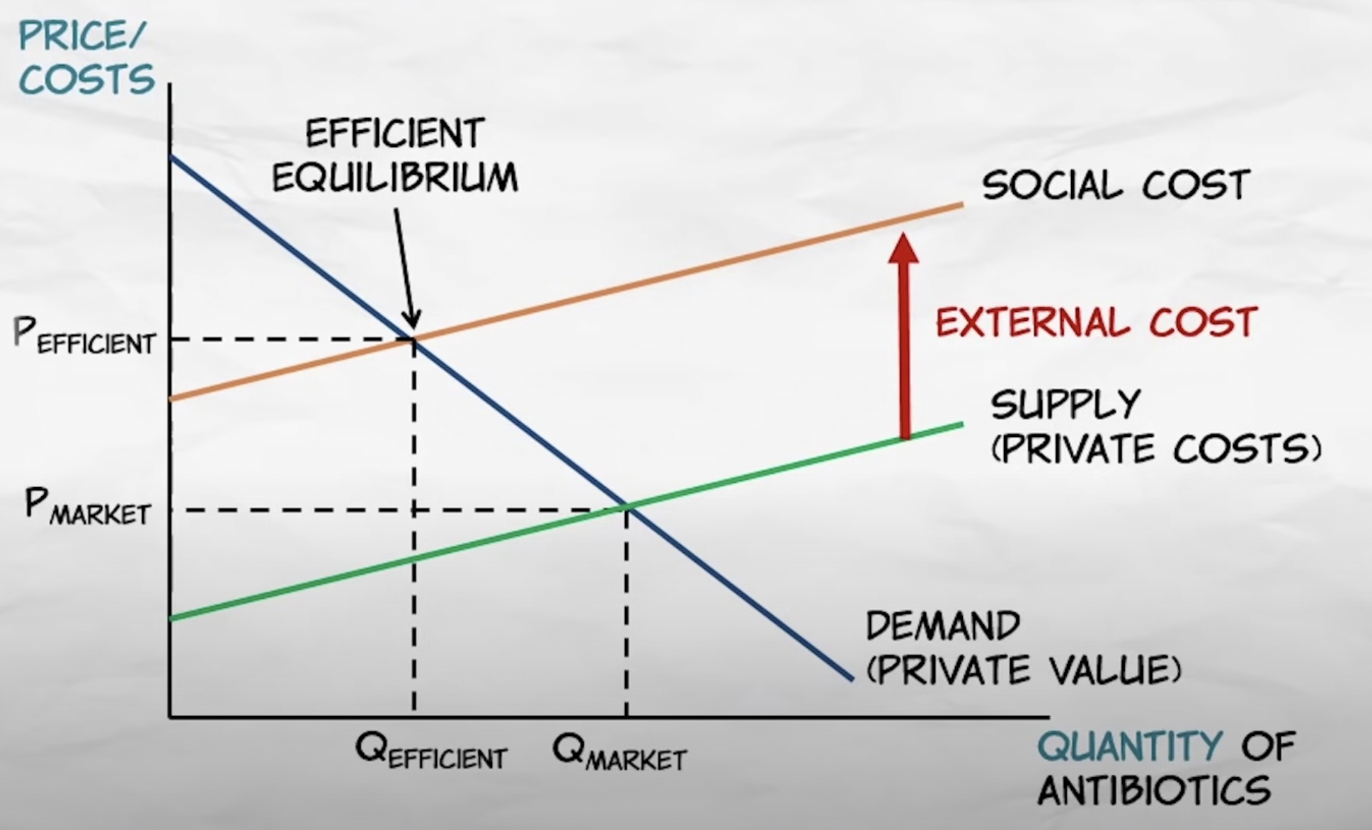

Slide 32
Negative Externalities
MC
Private Cost
EC
External Cost
Social Cost:
MC + EC

Slide 33
Negative Externalities
Measure the extent of the inefficiency in the market
Supply: Q^{S}=2p

Slide 34
Negative Externalities
Measure the extent of the inefficiency in the market
Supply: Q^{S}=2p
Inverse Supply: p=0.5Q

Slide 35
Negative Externalities
Measure the extent of the inefficiency in the market
Supply: Q^{S}=2p
Inverse Supply: p=0.5Q
MC=0.5Q

Slide 36
Negative Externalities
Measure the extent of the inefficiency in the market
Supply: Q^{S}=2p
Inverse Supply: p=0.5Q
MC=0.5Q
Demand: Q^{D}=20-2p

Slide 37
Negative Externalities
Measure the extent of the inefficiency in the market
Supply: Q^{S}=2p
Inverse Supply: p=0.5Q
MC=0.5Q
Demand: Q^{D}=20-2p
Inverse Demand: p=10-0.5Q

Slide 38
Negative Externalities
Measure the extent of the inefficiency in the market
Supply: Q^{S}=2p
Inverse Supply: p=0.5Q
MC=0.5Q
Demand: Q^{D}=20-2p
Inverse Demand: p=10-0.5Q
MB=10-0.5Q

Slide 39
Negative Externalities
Demand = Supply
In equilibrium:
10-0.5Q = 0.5Q
Q_{PC} = 10

Slide 40
Negative Externalities
Demand = Supply
In equilibrium:
10-0.5Q = 0.5Q
Q_{PC} = 10
P=10-0.5(10)=5
P=0.5(10)=5
p_{PC} = 5

Slide 41
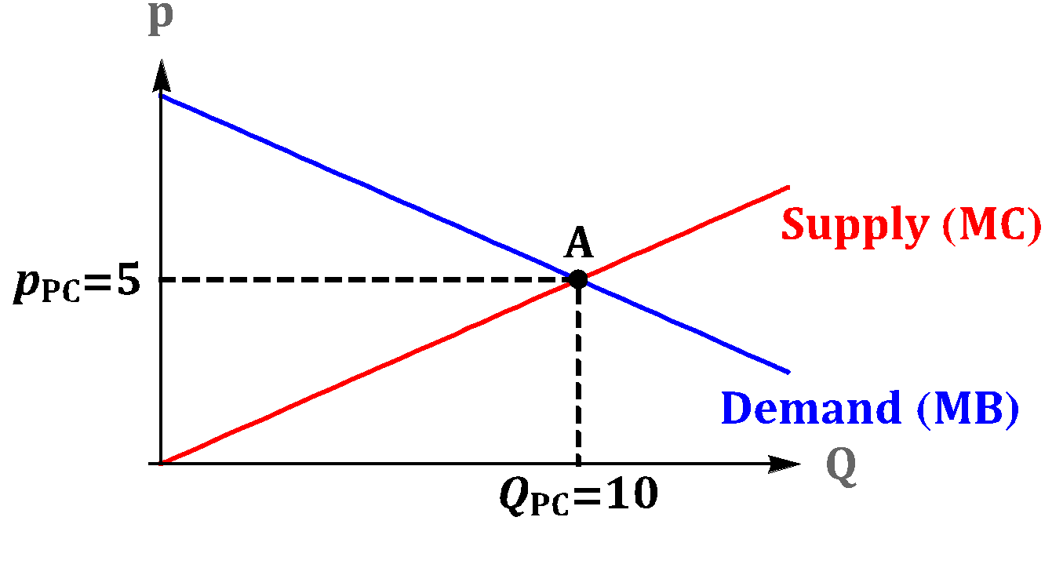
Negative Externalities

Slide 42
Negative Externalities
Suppose that there is a negative externality:
External Cost: 4
Social Cost: MC + External Cost = 0.5Q + 4

Slide 43
Negative Externalities
Socially Optimal (Efficient):
Demand = Social Cost

Slide 44
Negative Externalities
Socially Optimal (Efficient):
10-0.5Q = 0.5Q+4
Q_{SOC} = 6

Slide 45
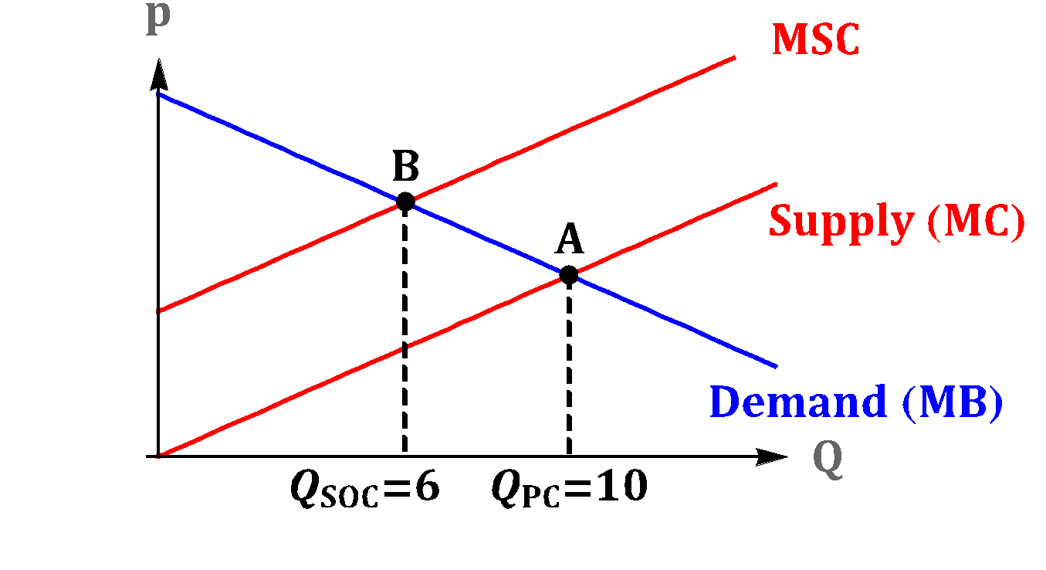
Negative Externalities
Social Cost Curve

Slide 46
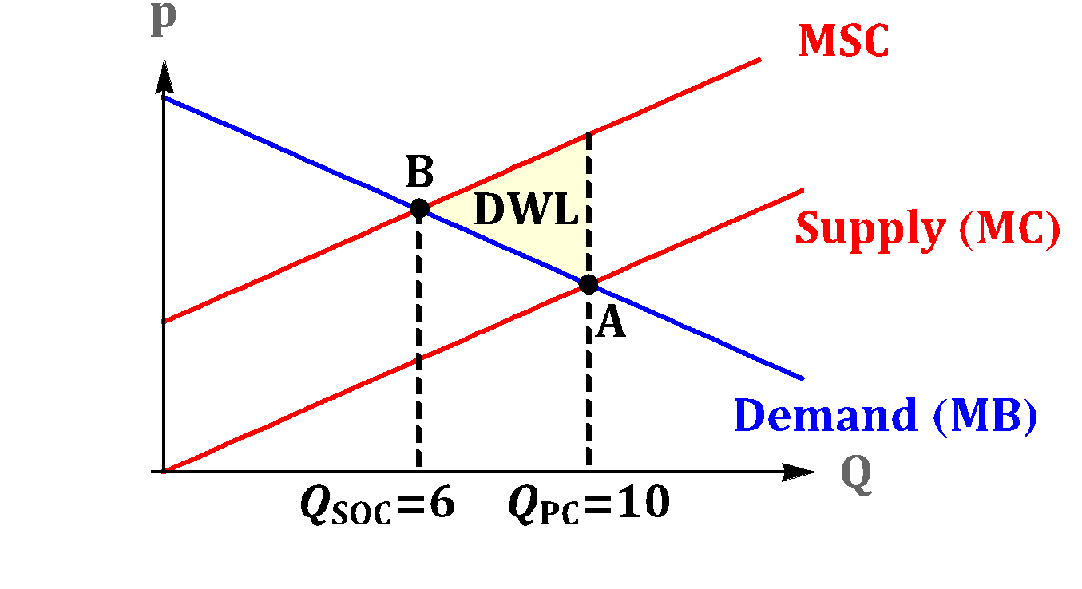
Negative Externalities
Social Cost Curve

Slide 47
Supply and demand for cases of bottled water are below. There is also an external cost associated with drinking bottled water due to the plastic waste.
Demand: P = 40 – 2Q External Cost = 6
Supply: P = 4 + Q
  What is the market equilibrium quantity?
  What is the socially optimal quantity?
  How much deadweight loss will exist at the market equilibrium?

Slide 48
Microeconomics for Business
Chapter 13 – Externalities and Public Goods
Government Intervention

Slide 49
Government Intervention
The negative externality results in deadweight loss because the perfectly competitive market produces too many units of output (Q_{PC}=10 units of output in our example).

Slide 50
What should be done about negative externalities?

Slide 51
What should be done about negative externalities?
One approach would be to ban or regulate the quantity
Approaches like this are called “command and control”
Downsides
Inefficiencies (quantity may be set too low or too high)
Paternalism
Underground markets

Slide 52
Government Intervention
The negative externality results in deadweight loss because the perfectly competitive market produces too many units of output (Q_{PC}=10 units of output in our example).
It is socially optimal for the market to produce the efficient quantity (Q_{SOC}=6 units of output in our example).

Slide 53
Government Intervention
The negative externality results in deadweight loss because the perfectly competitive market produces too many units of output (Q_{PC}=10 units of output in our example).
It is socially optimal for the market to produce the efficient quantity (Q_{SOC}=6 units of output in our example).
How can the government provide incentives to the market, in order to reach the desired (efficient) output?

Slide 54
Government Intervention
Do you remember what happens in a market when the government introduces a tax?

Slide 55
Government Intervention
Do you remember what happens in a market when the government introduces a tax?
the market shrinks

Slide 56
Government Intervention
Do you remember what happens in a market when the government introduces a tax?
the market shrinks
The idea of taxing markets featuring negative externalities was propose in 1920 by the British economist Arthur Pigou.

Slide 57
Government Intervention
Firms make decisions based on their own marginal private cost MC.

Slide 58
Government Intervention
Firms make decisions based on their own private costs.
Society cares about the Social Cost.

Slide 59
Government Intervention
To force firms to internalize the cost of the negative externality they generate, the government can impose on firms a tax equal to the external cost.

Slide 60
Government Intervention
Example:
Marginal Private Cost MC = 0.5Q
External Cost: 4
In this case, the government can recover efficiency by imposing a $4 per unit tax.
The $4 tax forces the market to internalize the $4 externality.

Slide 61
Government Intervention
Equilibrium
Example:
Supply: Q^{S}=2p^{S}
Q^{D} = Q^{S}
Demand: Q^{D}=20-2p^{D}
p^{D} = p^{S} + TAX
p^{D} = p^{S} + 4

Slide 62
Government Intervention
Equilibrium
Example:
Supply: Q^{S}=2p^{S}
Q^{D} = Q^{S}
20-2p^{D} = 2p^{S}
Demand: Q^{D}=20-2p^{D}
p^{D} = p^{S} + TAX
p^{D} = p^{S} + 4

Slide 63
Government Intervention
Equilibrium
Example:
Supply: Q^{S}=2p^{S}
Q^{D} = Q^{S}
20-2p^{D} = 2p^{S}
Demand: Q^{D}=20-2p^{D}
20-2(p^{S}+4) = 2p^{S}
p^{D} = p^{S} + TAX
p^{D} = p^{S} + 4

Slide 64
Government Intervention
Equilibrium
Example:
Supply: Q^{S}=2p^{S}
Q^{D} = Q^{S}
20-2p^{D} = 2p^{S}
Demand: Q^{D}=20-2p^{D}
20-2(p^{S}+4) = 2p^{S}
p^{D} = p^{S} + TAX
p^{S} = 3
p^{D} = p^{S} + 4

Slide 65
Government Intervention
Equilibrium
Example:
Supply: Q^{S}=2p^{S}
Q^{D} = Q^{S}
20-2p^{D} = 2p^{S}
Demand: Q^{D}=20-2p^{D}
20-2(p^{S}+4) = 2p^{S}
p^{D} = p^{S} + TAX
p^{S} = 3
p^{D} = 3+4=7
p^{D} = p^{S} + 4

Slide 66
Government Intervention
Equilibrium
Example:
Supply: Q^{S}=2p^{S}
Q^{D} = Q^{S}
20-2p^{D} = 2p^{S}
Demand: Q^{D}=20-2p^{D}
20-2(p^{S}+4) = 2p^{S}
p^{D} = p^{S} + TAX
p^{S} = 3
p^{D} = 3+4=7
p^{D} = p^{S} + 4
Q = 2(3) = 6

Slide 67
Government Intervention
Equilibrium
Example:
Supply: Q^{S}=2p^{S}
Q^{D} = Q^{S}
20-2p^{D} = 2p^{S}
Demand: Q^{D}=20-2p^{D}
20-2(p^{S}+4) = 2p^{S}
p^{D} = p^{S} + TAX
p^{S} = 3
p^{D} = 3+4=7
The tax eliminates the deadweight loss
p^{D} = p^{S} + 4
Q = 2(3) = 6

Slide 68
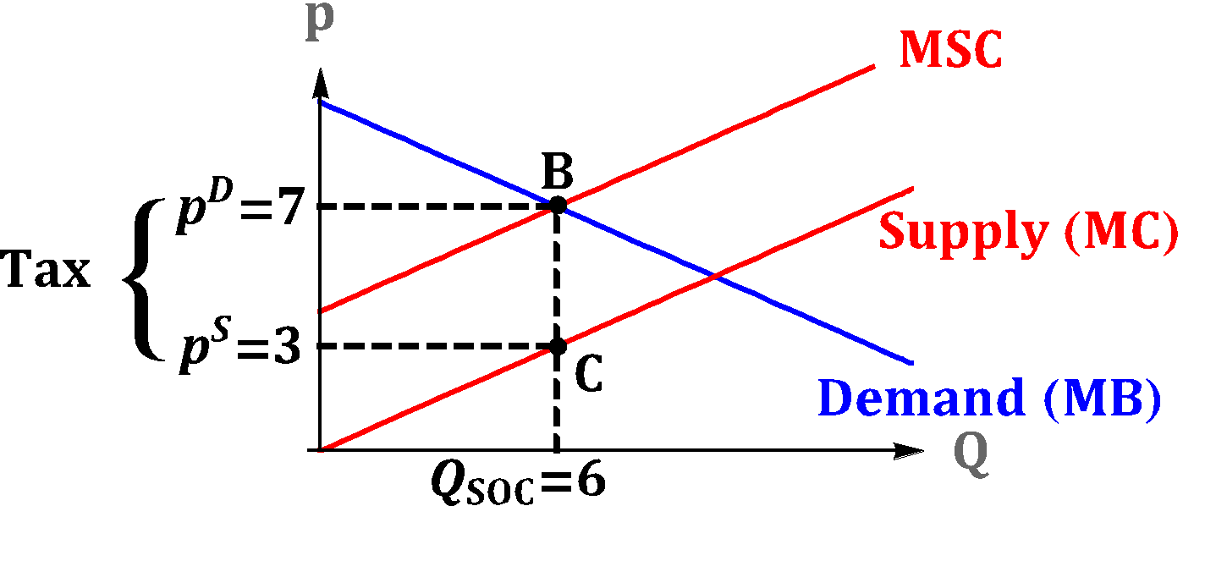
Government Intervention
SOCIAL COST

Slide 69
Pigovian Taxes
Easy right? Just set a tax equal to the external cost.
What could go wrong?

Slide 70
CASE STUDY: Command and Control vs. Market Based Solution
Finding the right policy to handle pollution is tricky

Slide 71
Quantity Taxes don’t incentivize emissions reduction
When the government imposes a tax on the output Q of a market with negative externality, it can achieve the goal of reducing production to the socially efficient amount Q_{SOC}.
However, taxes on the output Q do not provide incentives for firms to invest in technologies that reduce the negative externality.

Slide 72
Fees, Standards and Cap-and-Trade
Emissions (pollution):
Output Q
Emissions E
If the firm only pays taxes on the output Q that it produces, and not on the actual emissions E that it generates, the firm has little incentives to reduce emissions.

Slide 73
COMMAND AND CONTROL VS. MARKET to Attack Emissions
Charge a fee for the emissions (pollution fee):
Higher fees imply that firms will have a stronger incentive to invest in pollution abatement efforts.
Pollution standards:
The government establishes a maximum level of emission and forces firms to produce less than this maximum.

Slide 74
Market Solution
Fees are a more efficient tool than standards when different firms have different costs to reduce emissions, and the government does not know the costs of different firms.

Slide 75
Market Solution
Consider two firms with the same current level of emissions but different costs of reducing emission.
It is very expensive for Firm A to reduce emissions and it is cheaper for Firm B to reduce emissions.
Efficient: Firm B should reduce more of its emission than Firm A.

Slide 76
Market Solution
Consider two firms with the same current level of emissions but different costs of reducing emission.
It is very expensive for Firm A to reduce emissions and it is cheaper for Firm B to reduce emissions.
Efficient: Firm B should reduce more of its emission than Firm A.
With fees: Firm B reduces more of its emission than Firm A.

Slide 77
Market Solution
Consider two firms with the same current level of emissions but different costs of reducing emission.
It is very expensive for Firm A to reduce emissions and it is cheaper for Firm B to reduce emissions.
Efficient: Firm B should reduce more of its emission than Firm A.
With fees: Firm B reduces more of its emission than Firm A.
With standards: both firms reduce their emissions by the same amount.

Slide 78
Command and Control Advantages
Standards have an advantage over fees because it is more robust to certain errors.
When the government implements a particular fee, it hopes that firms will respond to this fee and reduce their emissions to E*.
The fee might be too high or too low, and lead to an emission level very far from E*.
When the government explicitly imposes an emission standard, it can be more confident in reaching the target E*.

Slide 79
Why not both?
The pros and cons of fees and standards led to the development of a new policy, called tradeable emissions permits, or cap-and-trade.
The government issues a certain number emissions permits. Each permit allows the firm that owns the permit to produce a certain amount of emissions.
Firms can trade the existing permits with each other.

Slide 80
Why not both?
The cap-and-trade combines positive features of both fees and standards.
The government has the ability of fixing the maximum level of emissions that can take place.
The market for permits contributes to the efficient allocation of permits.

Slide 81
https://mru.org/courses/principles-economics-microeconomics/clean-air-act-pollution-control

Slide 82
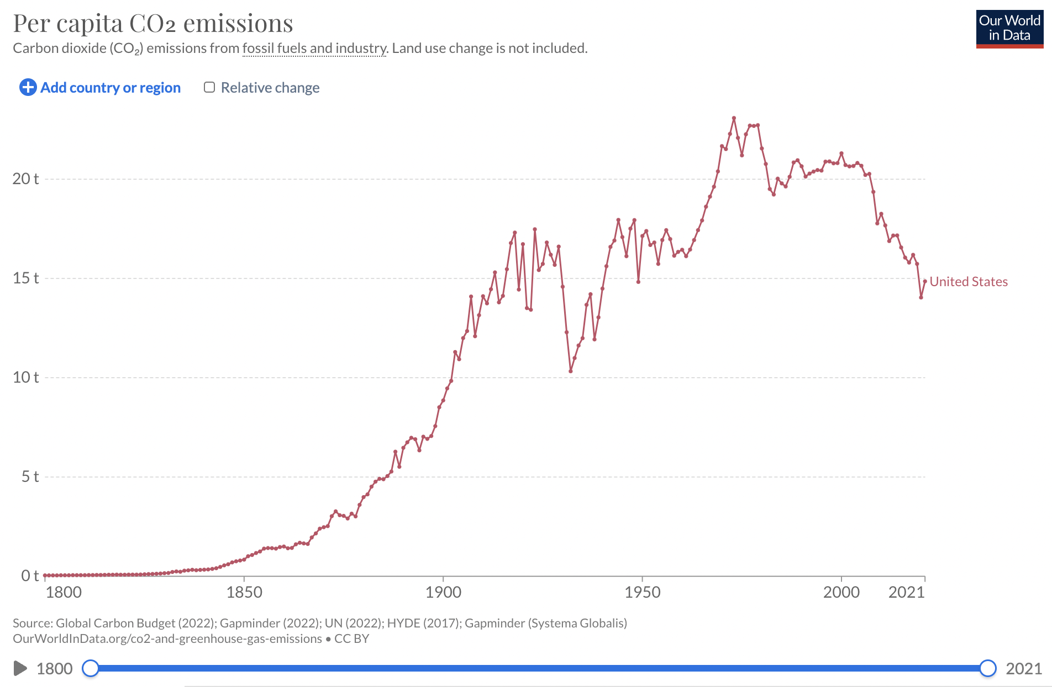

Slide 83
Overall issues with regulation
External costs/benefits are unknown
Cost of intervening might exceed gains to lowering deadweight loss

Slide 84
Microeconomics for Business
Chapter 13 – Externalities and Public Goods
Positive Externalities

Slide 85
Positive Externalities
Positive externality happens when the actions of economic agents generate benefits to others, but this is not reflected in the market.
This benefit for society is not captured by prices, which results in inefficient choices.

Slide 86
Positive Externalities
Example: consumption of a good or service generates benefits to others.
Consumer only takes into account her own value of good/service.

Slide 87
Positive Externalities
MB
Marginal Private Benefit
External
Benefit
External Benefit
Social Benefit:
MSB = MB + External Benefit

Slide 88
Positive Externalities
Example:
Producers are willing to sell for p=6.

Slide 89
Positive Externalities
Example:
Producers are willing to sell for p=6.
Consumers’ marginal private benefit MB=4

Slide 90
Positive Externalities
Example:
Producers are willing to sell for p=6.
Consumers will not purchase
Consumers’ marginal private benefit MB=4

Slide 91
Positive Externalities
Example:
Producers are willing to sell for p=6.
Consumers will not purchase
Consumers’ marginal private benefit MB=4
External benefit=4.

Slide 92
Positive Externalities
Example:
Producers are willing to sell for p=6.
Consumers’ marginal private benefit MB=4
Positive Surplus of $2 for Society
External benefit =4.
Social benefit MSB = MB+EB = 4+4 = 8.

Slide 93
Positive Externalities
Measure the extent of the inefficiency in the market

Slide 94
Positive Externalities
Measure the extent of the inefficiency in the market
Supply: Q^{S}=2p

Slide 95
Positive Externalities
Measure the extent of the inefficiency in the market
Supply: Q^{S}=2p
Inverse Supply: p=0.5Q

Slide 96
Positive Externalities
Measure the extent of the inefficiency in the market
Supply: Q^{S}=2p
Inverse Supply: p=0.5Q
MC=0.5Q

Slide 97
Positive Externalities
Measure the extent of the inefficiency in the market
Supply: Q^{S}=2p
Inverse Supply: p=0.5Q
MC=0.5Q
Demand: Q^{D}=12-2p

Slide 98
Positive Externalities
Measure the extent of the inefficiency in the market
Supply: Q^{S}=2p
Inverse Supply: p=0.5Q
MC=0.5Q
Demand: Q^{D}=12-2p
Inverse Demand: p=6-0.5Q

Slide 99
Positive Externalities
Measure the extent of the inefficiency in the market
Supply: Q^{S}=2p
Inverse Supply: p=0.5Q
MC=0.5Q
Demand: Q^{D}=12-2p
Inverse Demand: p=6-0.5Q
MB=6-0.5Q

Slide 100
Positive Externalities
In equilibrium:
MB = MC

Slide 101
Positive Externalities
In equilibrium:
MB = MC
6-0.5Q = 0.5Q
Q_{PC} = 6

Slide 102
Positive Externalities
In equilibrium:
MB = MC
6-0.5Q = 0.5Q
Q_{PC} = 6
MB=6-0.5(6)=3

Slide 103
Positive Externalities
In equilibrium:
MB = MC
6-0.5Q = 0.5Q
Q_{PC} = 6
MB=6-0.5(6)=3
MC=0.5(6)=3

Slide 104
Positive Externalities
In equilibrium:
MB = MC
6-0.5Q = 0.5Q
Q_{PC} = 6
MB=6-0.5(6)=3
MC=0.5(6)=3
p_{PC} = 3

Slide 105
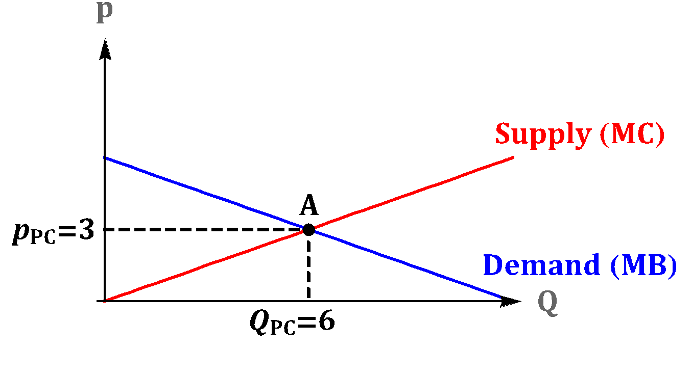
Positive Externalities

Slide 106
Positive Externalities
Suppose that there is a positive externality:
External Benefit: 4

Slide 107
Positive Externalities
Suppose that there is a positive externality:
External Benefit=4
Social Benefit: SB = MB + EB = 6 - 0.5Q + 4 = 10 - 0.5Q

Slide 108
Positive Externalities
Socially Optimal (Efficient):
Social Benefit = MC

Slide 109
Positive Externalities
Socially Optimal (Efficient):
Social Benefit = MC
10-0.5Q = 0.5Q
Q_{SOC} = 10

Slide 110
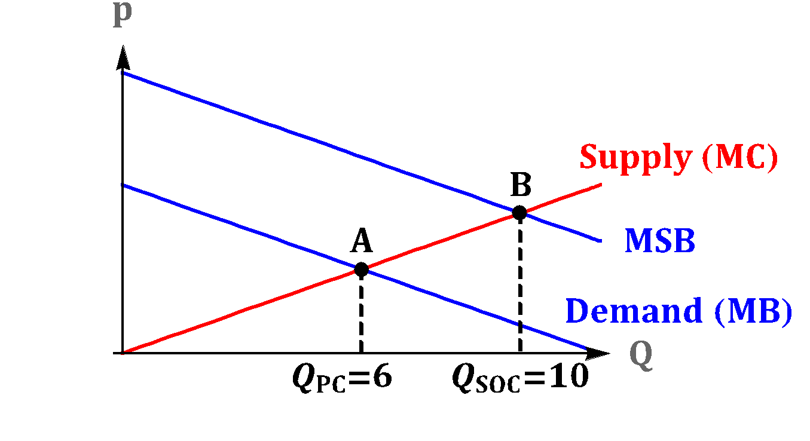
Positive Externalities
Social Benefit Curve

Slide 111
Positive Externalities
Social Benefit Curve

Slide 112
Positive Externalities
Social Benefit Curve

Slide 113
Positive Externalities
Social Benefit Curve

Slide 114
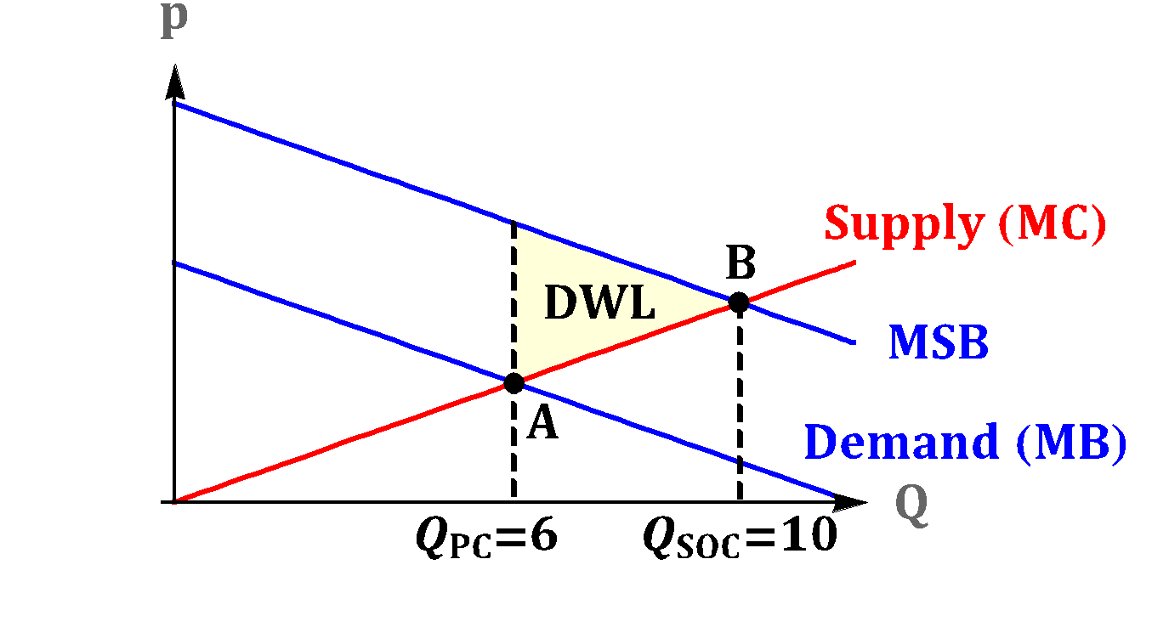
Positive Externalities
Social Benefit Curve

Slide 115
Positive Externalities
How can the government provide incentives to eliminate the deadweight loss?

Slide 116
Positive Externalities
How can the government provide incentives to eliminate the deadweight loss?
In the same way we used taxes to shrink a market with negative externalities, we can use subsidies to expand a market with positive externalities.

Slide 117
Positive Externalities
Example:
Marginal External Benefit MEB = 4

Slide 118
Positive Externalities
Example:
External Benefit = 4
The government can recover efficiency by offering a $4 per unit subsidy.

Slide 119
Supply and demand for flu vaccines are below. Since each vaccine decreases the risk of an outbreak, there exists an external benefit to society of $50 per vaccine.
Demand: P = 800 – 3Q Supply: P = 100 + 2Q
  Find the market equilibrium price and quantity.
  Find the socially optimal quantity of vaccines.
  Calculate deadweight loss that occurs in an unregulated market as a result of this externality.

Slide 120
To think about
Do religious rules exist to mitigate negative externalities?

